Slide 1
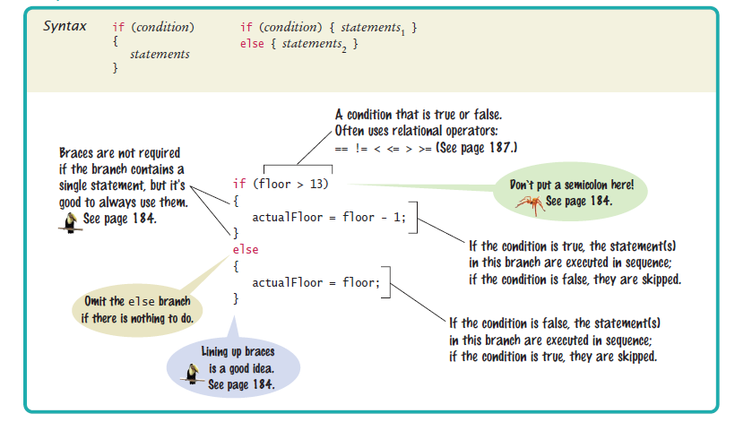

if (condition1) {
//DO SOMETHING IF condition==true; THEN EXIT IF BLOCK
} else if (condition2) {
//DO SOMETHING IF condition2==true, AND condition1 == false; THEN EXIT IF BLOCK
} else if (condition3) {
//DO SOMETHING IF condition3==true, AND condition2==false, AND condition1 == false;
//THEN EXIT IF BLOCK
} else if (condition4) {
//DO SOMETHING IF condition4 == true, condition3==false, AND condition2==false, AND condition1 == false;
//THEN EXIT IF BLOCK
} else {
//DO SOMETHING IF ALL PRECEEDING CONDITIONS ARE FALSE
}
//NEXT LINE TO BE EXECUTED WHEN IF BLOCK EXITS

Slide 2
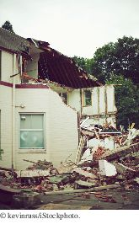
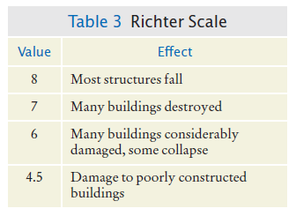
Multiple Alternatives

Slide 3
Example: damage done by earthquake of a given magnitude on the Richter scale:
if (richter >= 8.0)
{
description = "Most structures fall”;
}
else if (richter >= 7.0)
{
description = "Many buildings destroyed”;
}
else if (richter >= 6.0)
{
description = "Many buildings considerably damaged, some collapse”;
}
else if (richter >= 4.5)
{
description = "Damage to poorly constructed buildings”;
}
else
{
description = "No destruction of buildings”;
}

Slide 4
Multiple Alternatives: Sequences of Comparisons
As soon as one of the four tests succeeds:
The effect is displayed
No further tests are attempted.
If none of the four cases applies
The final else clause applies
A default message is printed.

Slide 5
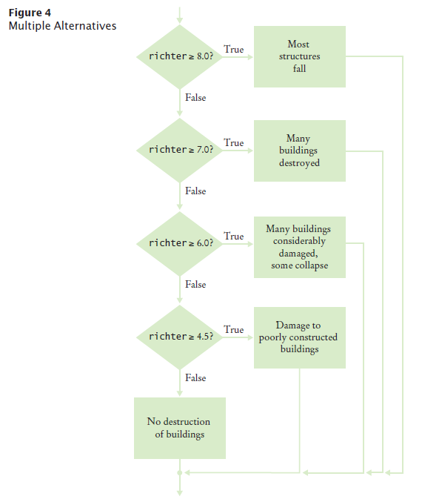
Multiple Alternatives - Flowchart

Slide 6
Multiple Alternatives
The order of the if and else if matters
Error
if (richter >= 4.5) // Tests in wrong order
{
description = "Damage to poorly constructed buildings”;
}
else if (richter >= 6.0)
{
description = "Many buildings considerably damaged, some collapse”;
}
else if (richter >= 7.0)
{
description = "Many buildings destroyed”;
}
else if (richter >= 8.0)
{
description = "Most structures fall”;
}
When using multiple if statements, test general conditions after more specific conditions.
The Debugger is your friend for tracking down problems in if blocks

Slide 7
Multiple Alternatives
In this example, must use if/else if/else sequence, not just multiple independent if statements
Error
if (richter >= 8.0) // Didn't use else
{
description = "Most structures fall”;
}
if (richter >= 7.0)
{
description = "Many buildings destroyed”;
}
if (richter >= 6.0)
{
description = "Many buildings considerably damaged, some collapse”;
}
if (richter >= 4.5)
{
description = "Damage to poorly constructed buildings”;
}
The alternatives are no longer exclusive.

Slide 8
Self Check 5.13
In a game program, the scores of players A and B are stored in variables scoreA and scoreB. Assuming that the player with the larger score wins, write an if/else if/else sequence that prints out "A won", "B won", or "Game tied".
Answer:
if (scoreA > scoreB)
{
System.out.println("A won");
}
else if (scoreA < scoreB)
{
System.out.println("B won");
}
else
{
System.out.println("Game tied");
}

Slide 9
Self Check 5.16
Beginners sometimes write statements such as the following:
if (price > 100)
{
discountedPrice = price – 20;
}
else if (price <= 100)
{
discountedPrice = price – 10;
}
Explain how this code can be improved.
Answer: The if (price <= 100) can be omitted (leaving just else), making it clear that the else branch is the sole alternative.

Slide 10
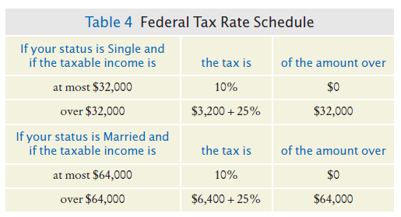
Nested Branches
Nested set of statements:
An if statement inside another
Example: Federal Income Tax
Tax depends on marital status and income

Slide 11
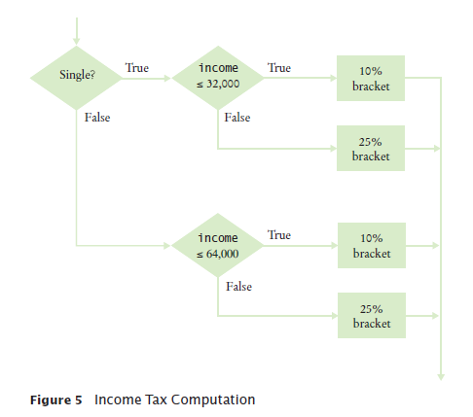
Nested Branches - Flowchart

Slide 12
section_4/TaxReturn.java
1 /**
2 A tax return of a taxpayer in 2008.
3 */
4 public class TaxReturn
5 {
6 public static final int SINGLE = 1;
7 public static final int MARRIED = 2;
8
9 private static final double RATE1 = 0.10;
10 private static final double RATE2 = 0.25;
11 private static final double RATE1_SINGLE_LIMIT = 32000;
12 private static final double RATE1_MARRIED_LIMIT = 64000;
13
14 private double income;
15 private int status;
16
17 /**
18 Constructs a TaxReturn object for a given income and
19 marital status.
20 @param anIncome the taxpayer income
21 @param aStatus either SINGLE or MARRIED
22 */
23 public TaxReturn(double anIncome, int aStatus)
24 {
25 income = anIncome;
26 status = aStatus;
27 }
28
Continued

Slide 13
section_4/TaxReturn.java
29 public double getTax()
30 {
31 double tax1 = 0;
32 double tax2 = 0;
33
34 if (status == SINGLE)
35 {
36 if (income <= RATE1_SINGLE_LIMIT)
37 {
38 tax1 = RATE1 * income;
39 }
40 else
41 {
42 tax1 = RATE1 * RATE1_SINGLE_LIMIT;
43 tax2 = RATE2 * (income - RATE1_SINGLE_LIMIT);
44 }
45 }
46 else
47 {
48 if (income <= RATE1_MARRIED_LIMIT)
49 {
50 tax1 = RATE1 * income;
51 }
52 else
53 {
54 tax1 = RATE1 * RATE1_MARRIED_LIMIT;
55 tax2 = RATE2 * (income - RATE1_MARRIED_LIMIT);
56 }
57 }
58
59 return tax1 + tax2;
60 }
61 }

